Slide 1


GITMAN/ JOEHNK/ BILLINGSLEY
PFIN
4
9
Insuring Your Health
Copyright ©2016 Cengage Learning. All Rights Reserved. May not be scanned, copied or duplicated, or posted to a publicly accessible website, in whole or in part.

Slide 2
LEARNING OUTCOMES
1 Discuss why having adequate health insurance is important, and identify the factors contributing to the growing cost of health insurance
2 Differentiate among the major types of health insurance plans, and identify major private and public health insurance providers and their programs
3 Analyze your own health insurance needs and explain how to shop for appropriate coverage
Copyright ©2016 Cengage Learning. All Rights Reserved. May not be scanned, copied or duplicated, or posted to a publicly accessible website, in whole or in part.
PFIN4 | CH9

Slide 3
LEARNING OUTCOMES (continued)
4 Explain the basic types of medical expenses covered by the policy provisions of health insurance plans
5 Assess the need for and features of long-term-care insurance
6 Discuss the features of disability income insurance and how to determine your need for it
Copyright ©2016 Cengage Learning. All Rights Reserved. May not be scanned, copied or duplicated, or posted to a publicly accessible website, in whole or in part.
PFIN4 | CH9

Slide 4

Health Insurance
Protects one against:
  Economic loss in the event of serious accidents or illnesses
  Rising cost of health care
Copyright ©2016 Cengage Learning. All Rights Reserved. May not be scanned, copied or duplicated, or posted to a publicly accessible website, in whole or in part.
PFIN4 | CH9

Slide 5
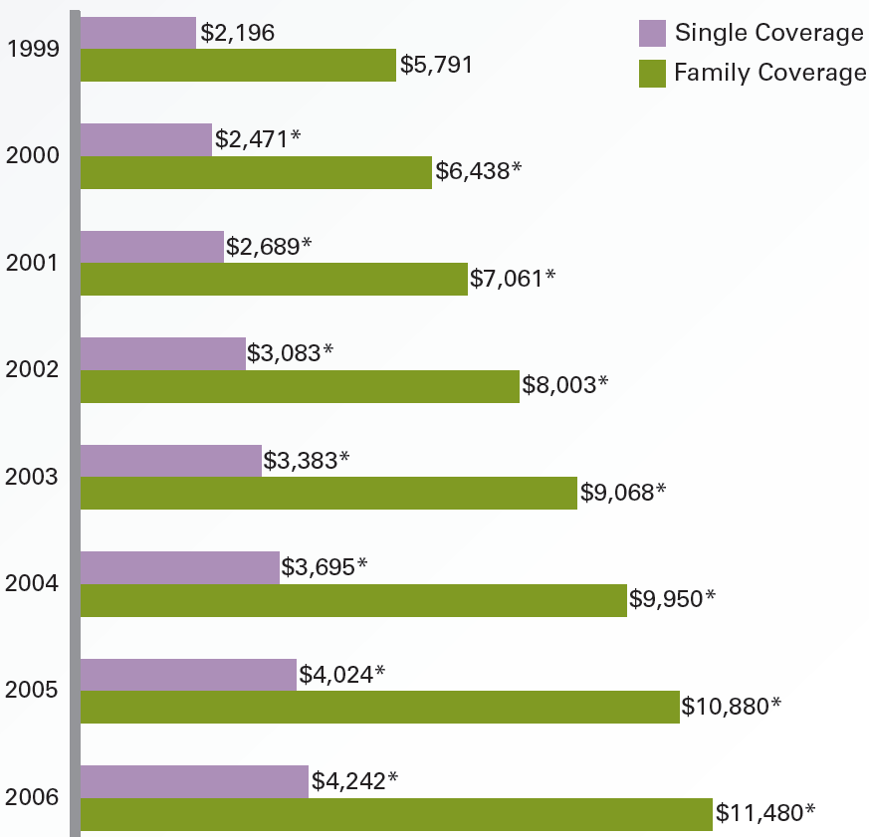
Exhibit 9.1
Average Annual Premiums for Single and Family Coverage 1999–2014
Source: Kaiser/HRET Survey of Employer-Sponsored Health Benefits, 1999–2014.
PFIN4 | CH9
Copyright ©2016 Cengage Learning. All Rights Reserved. May not be scanned, copied or duplicated, or posted to a publicly accessible website, in whole or in part.

Slide 6
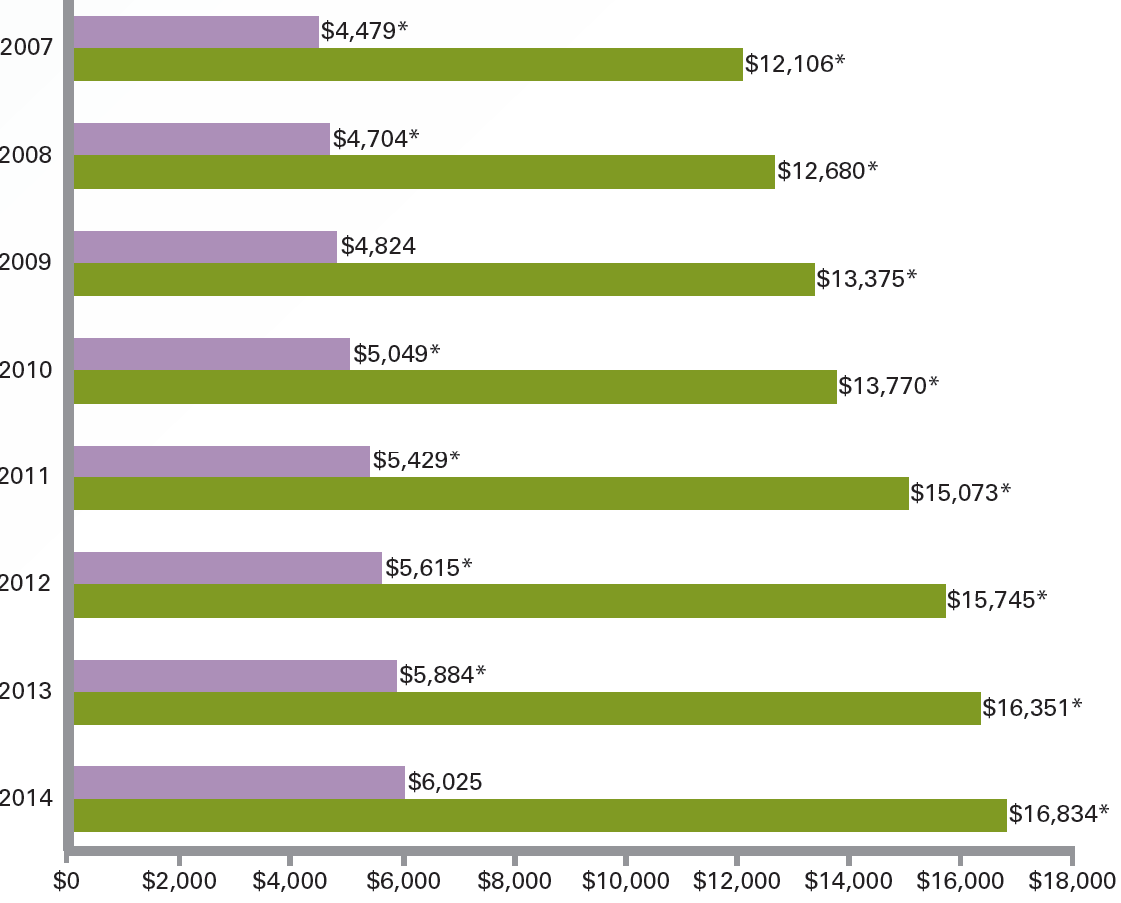
Exhibit 9.1
Average Annual Premiums for Single and Family Coverage 1999–2014
Source: Kaiser/HRET Survey of Employer-Sponsored Health Benefits, 1999–2014.
PFIN4 | CH9
Copyright ©2016 Cengage Learning. All Rights Reserved. May not be scanned, copied or duplicated, or posted to a publicly accessible website, in whole or in part.

Slide 7
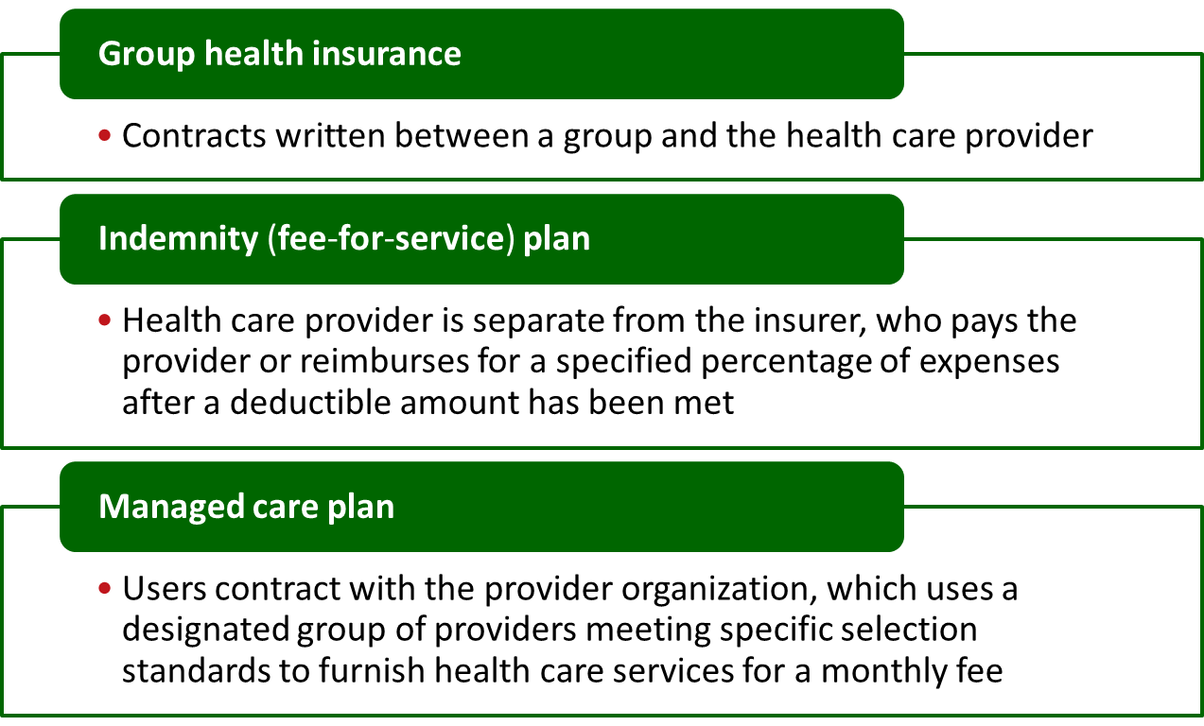
Private Health Insurance Plans
Copyright ©2016 Cengage Learning. All Rights Reserved. May not be scanned, copied or duplicated, or posted to a publicly accessible website, in whole or in part.
PFIN4 | CH9

Slide 8
Health Maintenance Organization (HMO)
Provides comprehensive health care services
  Group HMO: Provides health care services from a central facility
  Individual practice association (IPA): Provides services from own offices and affiliated community hospitals
Copyright ©2016 Cengage Learning. All Rights Reserved. May not be scanned, copied or duplicated, or posted to a publicly accessible website, in whole or in part.
PFIN4 | CH9

Slide 9
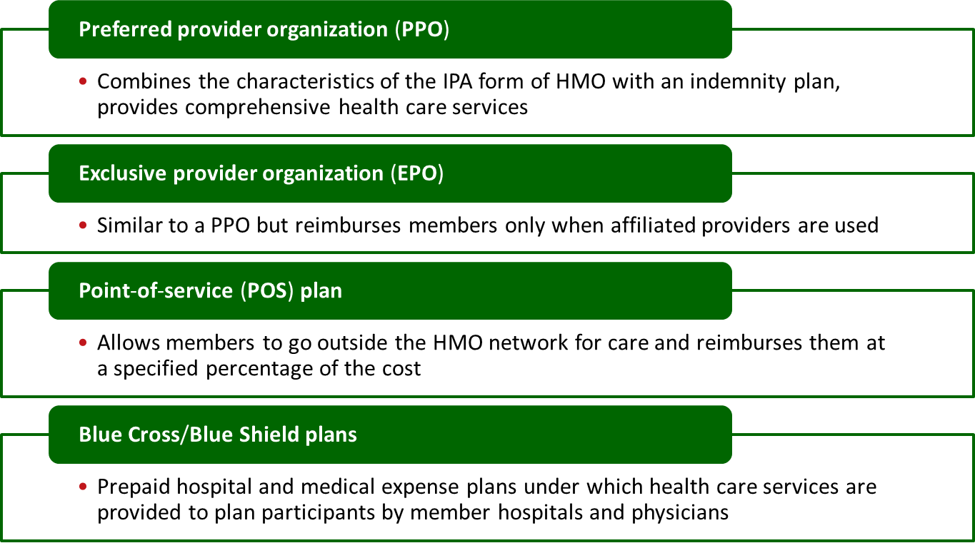
Private Health Insurance Plans
Copyright ©2016 Cengage Learning. All Rights Reserved. May not be scanned, copied or duplicated, or posted to a publicly accessible website, in whole or in part.
PFIN4 | CH9

Slide 10
Government Health Insurance Plan
Medicare
  Helps persons age 65 and over and others who receive monthly Social Security disability benefits to meet their health care costs
  Basic hospital insurance
    Provides inpatient hospital services for the first 90 days of illness
  Supplementary medical insurance (SMI)
    Provides payments for services not covered under basic hospital insurance
Copyright ©2016 Cengage Learning. All Rights Reserved. May not be scanned, copied or duplicated, or posted to a publicly accessible website, in whole or in part.
PFIN4 | CH9

Slide 11
Government Health Insurance Plan
  Medicare Advantage plans
    Administered by private providers
  Prescription drug coverage
    Covers brand-name and generic prescription drugs at participating pharmacies
Medicaid
  State-run public assistance program, provides health insurance benefits to those who are unable to pay for health care
Copyright ©2016 Cengage Learning. All Rights Reserved. May not be scanned, copied or duplicated, or posted to a publicly accessible website, in whole or in part.
PFIN4 | CH9

Slide 12
Government Health Insurance Plan
Workers’ compensation insurance
  Required by state and federal governments
  Paid nearly in full by employers in most states
    Compensates workers for job-related illness or injury
Copyright ©2016 Cengage Learning. All Rights Reserved. May not be scanned, copied or duplicated, or posted to a publicly accessible website, in whole or in part.
PFIN4 | CH9

Slide 13
Elements of Affordable Health Care Act (ACA) of 2010
Individual mandate
Coverage of young adult and pre-existing health conditions
Health care insurance exchanges
Small-firm coverage of employees
Copyright ©2016 Cengage Learning. All Rights Reserved. May not be scanned, copied or duplicated, or posted to a publicly accessible website, in whole or in part.
PFIN4 | CH9

Slide 14
Factors to be Considered in a Health Insurance Plan
Risk avoidance
Loss prevention and control
Risk assumption
Copyright ©2016 Cengage Learning. All Rights Reserved. May not be scanned, copied or duplicated, or posted to a publicly accessible website, in whole or in part.
PFIN4 | CH9

Slide 15
Available Coverage and Resources
Some employers offer only one plan and pay either all or part premium
  Employee must evaluate his or her options
  Flexible-benefit (cafeteria) plan
    Allows employees to choose fringe benefits
  Health reimbursement account (HRA)
    Employers place contributions that employees can use to pay for medical expenses
  Health savings account (HSA)
    Tax-free savings account used to spend on routine medical costs
Copyright ©2016 Cengage Learning. All Rights Reserved. May not be scanned, copied or duplicated, or posted to a publicly accessible website, in whole or in part.
PFIN4 | CH9

Slide 16
Considerations Before Choosing the Particular Plan
Importance of cost as compared with having freedom of choice
Scope of reimbursement
Required types of coverage
Credentials of the participating doctors
Own age and health conditions
Copyright ©2016 Cengage Learning. All Rights Reserved. May not be scanned, copied or duplicated, or posted to a publicly accessible website, in whole or in part.
PFIN4 | CH9

Slide 17
Types of Medical Expense Coverage
Hospitalization
Surgical expenses
Physician expenses
Major medical plan
  Supplements the basic coverage of hospitalization, surgical, and physicians expenses
Copyright ©2016 Cengage Learning. All Rights Reserved. May not be scanned, copied or duplicated, or posted to a publicly accessible website, in whole or in part.
PFIN4 | CH9

Slide 18
Types of Medical Expense Coverage
Comprehensive major medical insurance
  Coverage for basic hospitalization, surgical, and physician expense and major medical protection is combined into a single policy
Dental services
Copyright ©2016 Cengage Learning. All Rights Reserved. May not be scanned, copied or duplicated, or posted to a publicly accessible website, in whole or in part.
PFIN4 | CH9

Slide 19
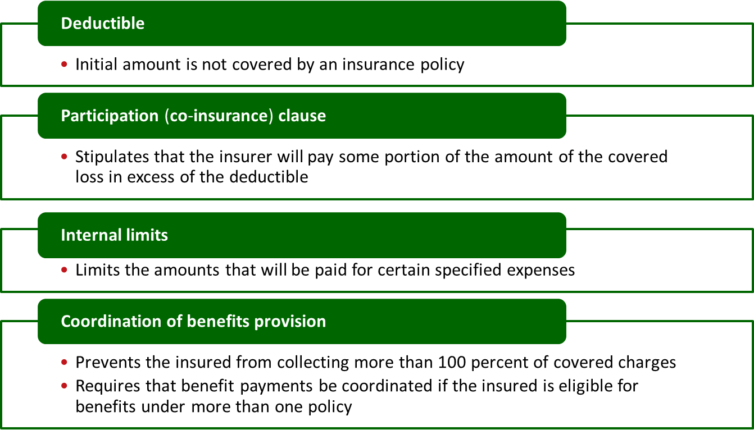
Terms of Payment
Copyright ©2016 Cengage Learning. All Rights Reserved. May not be scanned, copied or duplicated, or posted to a publicly accessible website, in whole or in part.
PFIN4 | CH9

Slide 20
Terms of Coverage
Persons and places covered
Cancellation
Pre-existing condition
Pregnancy and abortion
Mental illness
Rehabilitation coverage
Continuation of group coverage
Copyright ©2016 Cengage Learning. All Rights Reserved. May not be scanned, copied or duplicated, or posted to a publicly accessible website, in whole or in part.
PFIN4 | CH9

Slide 21
Preexisting Condition
Preexisting condition clause
  Permits permanent or temporary exclusion of coverage for any physical or mental problems the insured had at the time the policy was purchased
Health Insurance Probability and Accountability Act (HIPAA)
  Protects people’s ability to obtain continued health insurance after they leave a job or retire
Copyright ©2016 Cengage Learning. All Rights Reserved. May not be scanned, copied or duplicated, or posted to a publicly accessible website, in whole or in part.
PFIN4 | CH9

Slide 22
Cost Containment Provisions for Medical Expense Plans
Preadmission certification
Continued stay review
Second surgical opinions
Waiver of co-insurance
Limitation of insurer’s responsibility
Copyright ©2016 Cengage Learning. All Rights Reserved. May not be scanned, copied or duplicated, or posted to a publicly accessible website, in whole or in part.
PFIN4 | CH9

Slide 23
Long-Term Care
Delivery of medical and personal care to persons with chronic medical conditions resulting from either illness or frailty
Does not include hospital care
Copyright ©2016 Cengage Learning. All Rights Reserved. May not be scanned, copied or duplicated, or posted to a publicly accessible website, in whole or in part.
PFIN4 | CH9

Slide 24
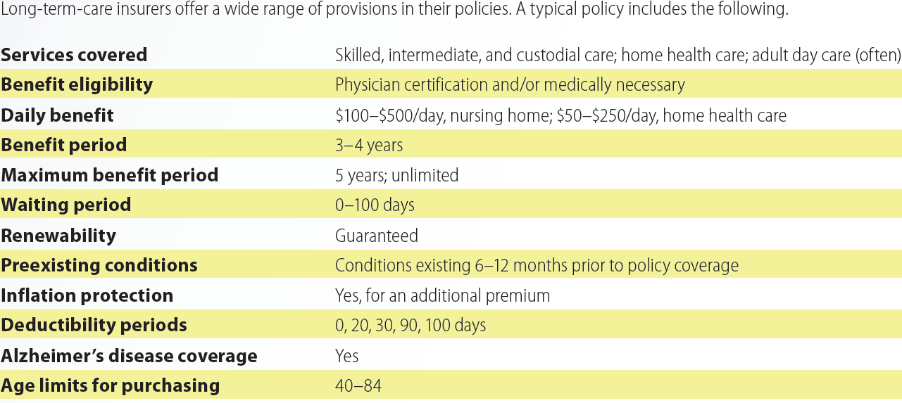

Exhibit 9.3
Typical Provisions in Long-Term-Care Insurance Policies
Copyright ©2016 Cengage Learning. All Rights Reserved. May not be scanned, copied or duplicated, or posted to a publicly accessible website, in whole or in part.
PFIN4 | CH9

Slide 25
Guidelines for Choosing a Right Policy
Buy the policy when healthy
Buy the right types and only the required coverages
Understand what the policy covers and when it pays benefits
Copyright ©2016 Cengage Learning. All Rights Reserved. May not be scanned, copied or duplicated, or posted to a publicly accessible website, in whole or in part.
PFIN4 | CH9

Slide 26
Disability Income Insurance
Provides families with weekly or monthly payments to replace income when the insured is unable to work because of:
  Covered illness
  Injury
  Disease
Copyright ©2016 Cengage Learning. All Rights Reserved. May not be scanned, copied or duplicated, or posted to a publicly accessible website, in whole or in part.
PFIN4 | CH9

Slide 27
Features of Disability Income Insurance Policies
Definition of disability
Benefit amount and duration
Probationary period
Waiting period
Renewability
Copyright ©2016 Cengage Learning. All Rights Reserved. May not be scanned, copied or duplicated, or posted to a publicly accessible website, in whole or in part.
PFIN4 | CH9

Slide 28
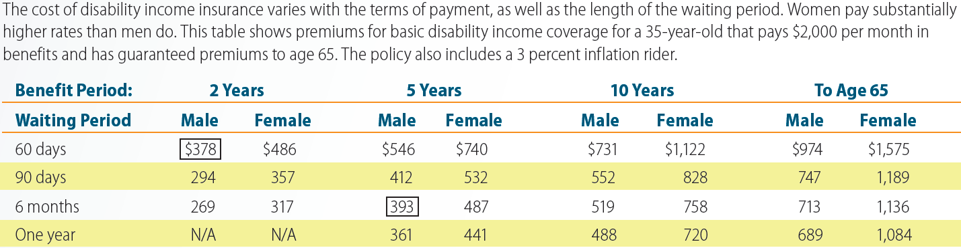
Exhibit 9.4
Representative Disability Income Insurance Premium Costs
Copyright ©2016 Cengage Learning. All Rights Reserved. May not be scanned, copied or duplicated, or posted to a publicly accessible website, in whole or in part.
PFIN4 | CH9

Slide 29
KEY TERMS
Group health insurance
Indemnity
Managed care plan
Health maintenance organization
Group HMO
Individual practice association
Preferred provider organization
Exclusive provider organization
Point-of-service
Blue Cross/Blue Shield plans
Medicare
Supplementary medical insurance
Medicare Advantage plans
Prescription drug coverage
Copyright ©2016 Cengage Learning. All Rights Reserved. May not be scanned, copied or duplicated, or posted to a publicly accessible website, in whole or in part.
PFIN4 | CH9

Slide 30
SUMMARY
Health insurance helps you pay both routine and major medical care costs
Health insurance decisions can only be made by considering potential areas of loss, types of coverage and other resources
One must compare and contrast what each insurance plan covers and how each plan’s policy provisions may affect you and your family
Copyright ©2016 Cengage Learning. All Rights Reserved. May not be scanned, copied or duplicated, or posted to a publicly accessible website, in whole or in part.
PFIN4 | CH9

Slide 31


